Slide 1
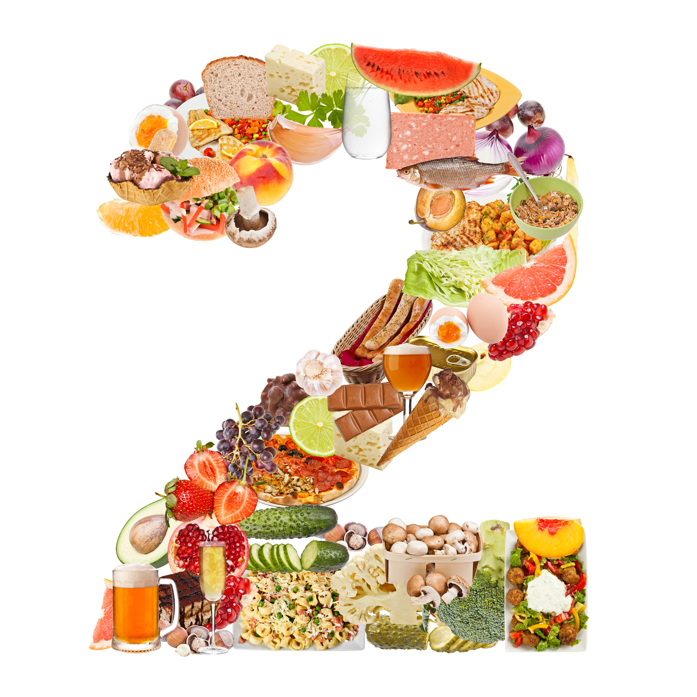
Risk of developing Type II Diabetes
Using Data Science models, I’m attempting to predict the risk of developing Type 2 diabetes given an Individuals vital health signs.
Karun Siddana
August 24th, 2015

Slide 2
Problem Statement
There is an increasing growing problem of obesity and hypertension in the United States that leads to Type 2 diabetes. A sure shot test for type 2 diabetes has not been developed due to the complexities in the disease.
Unlike Type 1 diabetes which can be detected at birth, type 2 diabetes is dependent on the individuals lifestyle, exercise component, nutrition and genetic makeup.
Early detection of the indicators of Type 2 diabetes would allow us to avoid bad food habits and prevent/mitigate the risk of developing type 2 diabetes.

Slide 3
Data Collection
The Data used was from the Department of Biostatistics at the Vanderbilt University
http://biostat.mc.vanderbilt.edu/wiki/Main/DataSets
http://cs-people.bu.edu/dgs/courses/cs105/hall_of_fame/awm.html

Slide 4
Data
Using the following predictors, I am trying to predict the outcome, whether a person is positive for diabetes.
Total Cholesterol Level (chol, hdl, ldl)
Blood Glucose Level (stab.glu)
HDL
Age
Gender
Body Frame
Systolic Blood Pressure levels (bp.1s, bp.1d)
Waist Size
Hip Size
Glycosylated Hemoglobin (glyhb) – Response/Output

Slide 5
Data Preparation
Lots of missing data for the Response Value.
I searched online, for formulas that could help determine a Glycosylated Hemoglobin (glyhb) – Response/Output based on the average Glucose Level.
Reference: http://professional.diabetes.org/glucosecalculator.aspx relationship between eAG and A1C/glyhb: 28.7 X A1C – 46.7 = eAG

Slide 6
Data Preparation
Lots of missing data for the Response Value.
I searched online, for formulas that could help determine a Glycosylated Hemoglobin (glyhb) – Response/Output based on the average Glucose Level.
Reference: http://professional.diabetes.org/glucosecalculator.aspx relationship between eAG and A1C: 28.7 X A1C – 46.7 = eAG
Generated my own formula, simple formula based on Linear Regression and used y = mx + c.
y = 0.028*x + 2.453 (where x = stab.glu, y = glyhb)

Slide 7
Data Exploration
Firstly I plotted several graphs to understand the correlation between the indicators and the response.
Total Data Points
Total Patients = 403
What kind of data do I have here?
Male: 169
Female: 234

Slide 8
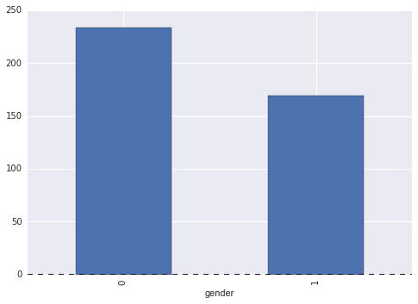
Data Exploration
Gender:
female 234
male 169

Slide 9
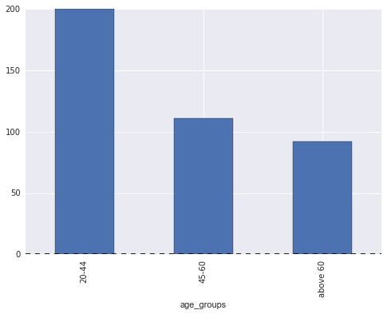
Data Exploration
age_groups:
20 – 44 | 200
45 – 60 | 111
Above 60 | 92

Slide 10
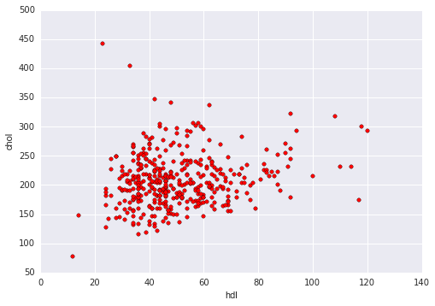
Plot – Scatter Plot (hdl vs chol)

Slide 11
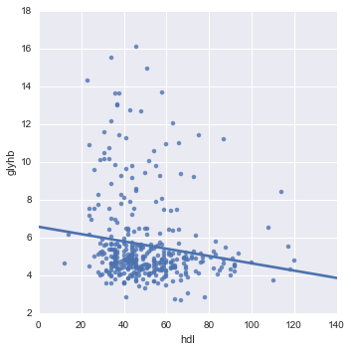
Plot – hdl vs glyhb
X-axis: High Cholesterol
Y-axis: Glycosylated Hemoglobin

Slide 12
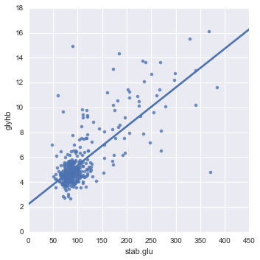
Plot – stab.glu x glyhb
X-axis: Blood Glucose Level
Y-axis: Glycosylated Hemoglobin

Slide 13
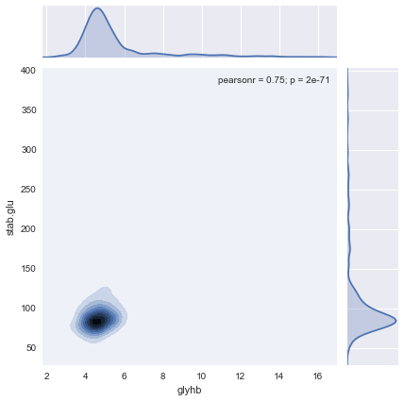
Kernel Density Plot – hdl x glyhb
X-axis: Glycosylated Hemoglobin
Y-axis: Blood Glucose Level

Slide 14
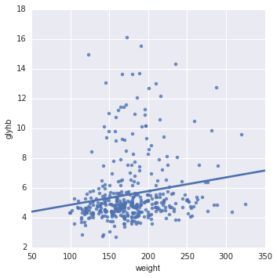
sns.lmplot– weight x glyhb
X-axis: Weight
Y-axis: Glycosylated Hemoglobin

Slide 15
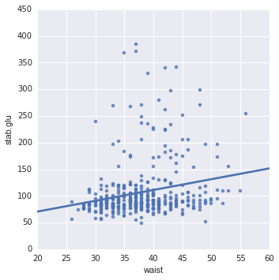
sns.lmplot– waist x stab.glu
X-axis: waist
Y-axis: Blood Glucose Level

Slide 16
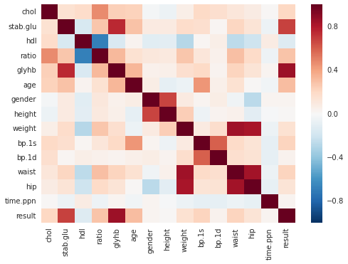
Heatmap

Slide 17
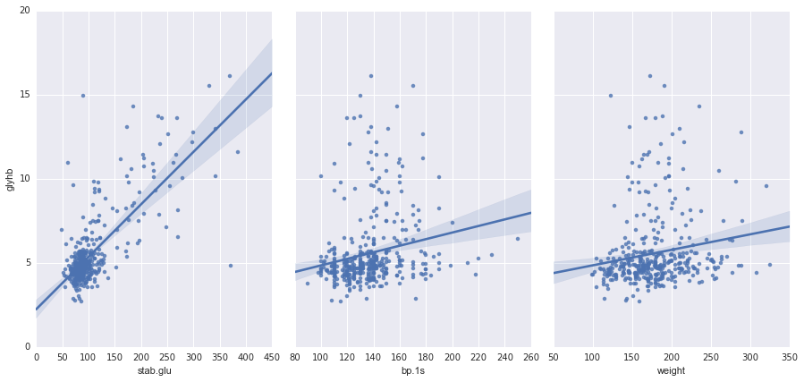
sns.pairplot

Slide 18
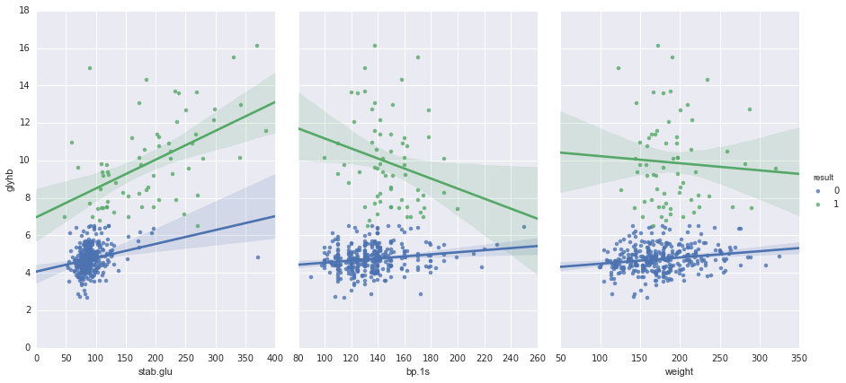
sns.pairplot

Slide 19
Logistic Regression
features = ['stab.glu’] x = diabetes_data[features] y = diabetes_data['glyhb’] y_category = np.where(y > 6.5, 1, 0)
Fit the model to a X_train and y_train
[('stab.glu', 0.027)]
Confusion Matrix
[86 0 ] [7 8]
Accuracy = 0.91 or 91%
Specificity = 1.0
Sensitivity = 0.60

Slide 20
Linear Regression Model
features = ['stab.glu’, 'weight’] x = diabetes_data[features] y = diabetes_data['glyhb’]
Train Test Split / Fit the Linear Model [('stab.glu', 0.028), ('weight', 0.0021)]
Mean Absolute Error = 0.91
Mean Squared Error = 1.43 (Remember the scale of the Output it is between 3.5 – 15.0)

Slide 21
Linear Regression Model
Cross Validation Score – Mean Squared Error -3.67 -2.02 -0.76 -3.60 -0.55

Slide 22
Linear Regression Model
Cross Validation Score – Mean Squared Error -3.67 -2.02 -0.76 -3.60 -0.55
This is Terrible !!!!
Very large Mean Squared Error for an output that ranges between 3.5 – 15.

Slide 23
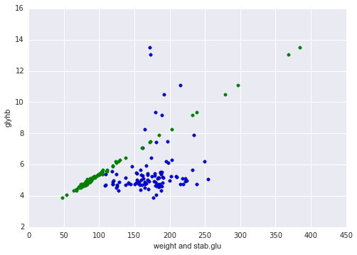
Linear Regression Model

Slide 24
Stats Linear Regression Model
lm = smf.ols(formula='glyhb ~ avg_glu + bp_1s + bp_1d + chol + weight + age + waist + hip + gender + hdl + ratio', data=diabetes_data).fit()
P- Values:

Slide 25
Stats Linear Regression Model
Metrics Rsquared = 0.596
Metrics R2_Score = 0.565

Slide 26
KNN Classification Model
features = ['weight', 'gender', 'age’] x = diabetes_data[features] y = np.where(diabetes_data.glyhb > 6.5, 1, 0)
Knn = KNeighborsClassifier(n_neighbors= 3)
Cross Validation = 5
[ 0.80952381 0.8 0.8 0.8 0.8 ]

Slide 27
KNN Classification Model
features = ['weight', 'gender', 'age’] x = diabetes_data[features] y = np.where(diabetes_data.glyhb > 6.5, 1, 0)
Knn = KNeighborsClassifier(n_neighbors= 3)
Cross Validation = 5
[ 0.80952381 0.8 0.8 0.8 0.8 ]
features = ['stab.glu', 'weight', 'gender', 'age’] x = diabetes_data[features] y = np.where(diabetes_data.glyhb > 6.5, 1, 0)
knn = KNeighborsClassifier(n_neighbors= 2)
Cross Validation = 5
[ 0.95238095 0.95 0.9 1. 1. ]

Slide 28
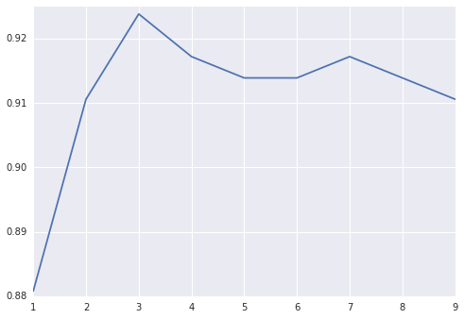
KNN classification Model

Slide 29
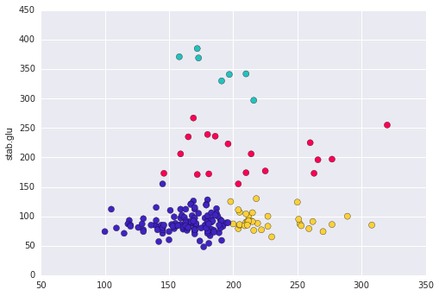
K-Means Clustering Modeling
columns = ['weight', 'stab.glu', 'bp.1s', 'glyhb'] Only on Males

Slide 30
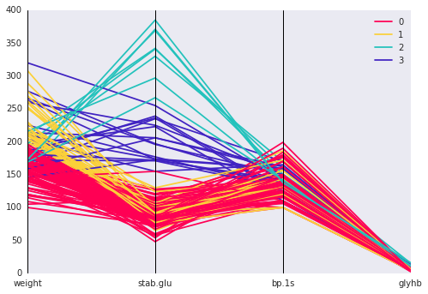
K-Means Clustering Modeling
columns = ['weight', 'stab.glu', 'bp.1s', 'glyhb'] Only on Males

Slide 31
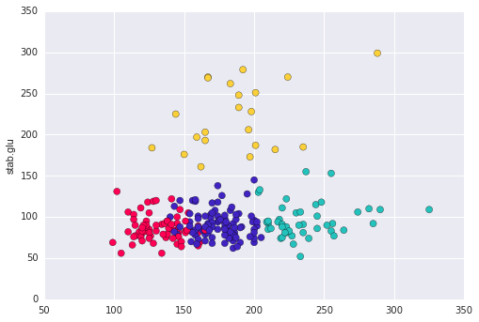
K-Means Clustering Modeling
columns = ['weight', 'stab.glu', 'bp.1s', 'glyhb'] Only on Females

Slide 32
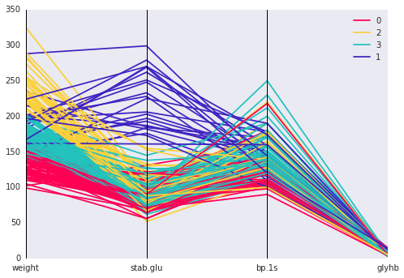
K-Means Clustering Modeling
columns = ['weight', 'stab.glu', 'bp.1s', 'glyhb'] Only on Females

Slide 33
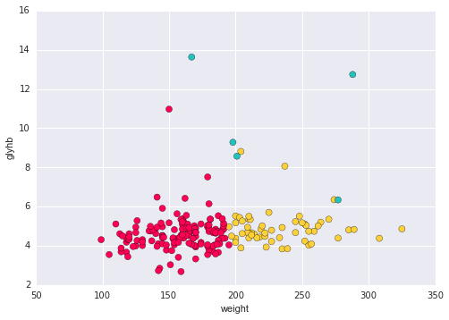
K-Means Clustering Modeling
Columns = ['weight', 'stab.glu', 'bp.1s', 'glyhb', 'waist', 'hip']
Only on Age Groups = 20 – 44

Slide 34
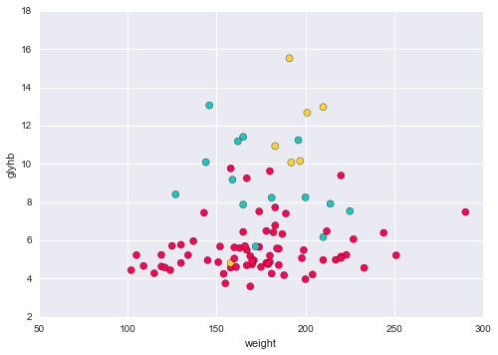
K-Means Clustering Modeling
Columns = ['weight', 'stab.glu', 'bp.1s', 'glyhb', 'waist', 'hip']
Only on Above 60

Slide 35
Decision Tree Classifier
response = diabetes_data['result’] del diabetes_data['result’] del diabetes_data['glyhb']
ctree = tree.DecisionTreeClassifier(random_state=1, max_depth=3)
Accuracy = 0.9108
Feature Importance: Next Page

Slide 36
Decision Tree Classifier
Feature Importance:
Accuracy = 0.91
This shows that Weight is not as important with a depth of 3. So I did a grid Search to find the most optimum depth.

Slide 37
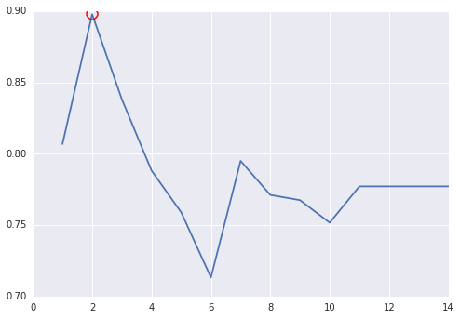
Decision Tree Classifier
Depth = 2

Slide 38
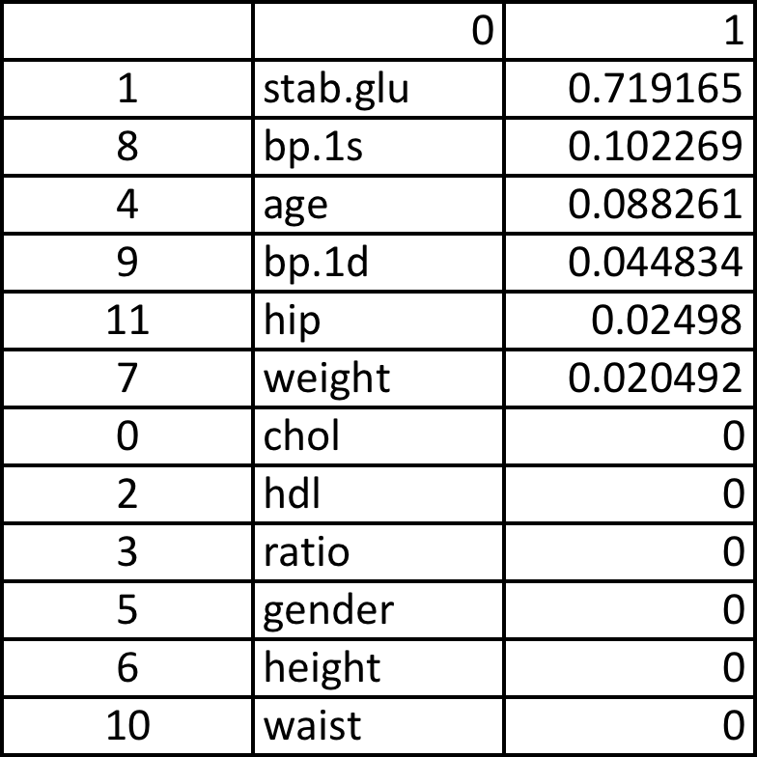
Decision Tree Classifier
Even though the roc_auc curve shows that 2 is the optimum maximum depth, it doesn’t match up with my hypothesis or any of the results from Linear Regression.
So I changed the depth = 4
Accuracy = 0.88

Slide 39
Support Vector Matrices
features = ['stab.glu', 'weight', 'gender', 'age']
Used Train Test Split
Fit it it to my Training Data
Scored it using the Test Data
cross_val_score(clf, X_test, y_test, cv=5, scoring='accuracy').mean()
Accuracy = 0.85

Slide 40
Logistic Regression
features = ['stab.glu’, ‘weight’, ‘bp.1s’] x = diabetes_data[features] y = diabetes_data['glyhb’] y_category = np.where(y > 6.5, 1, 0)
Fit the model to a X_train and y_train
('stab.glu', 0.0328)
('weight', -0.0060)
('bp.1s', 0.0040)
('bp.1d', -0.0281)
Confusion Matrix
[86 0 ] [5 10]
Accuracy = 0.95 or 95%
Specificity = 1.0
Sensitivity = 0.66

Slide 41
Linear Regression Model
features = ['stab.glu','weight', 'bp.1s’] x = diabetes_data[features] y = diabetes_data['glyhb’]
Train Test Split / Fit the Linear Model
Mean Absolute Error = 0.91
Mean Squared Error = 1.42 (Remember the scale of the Output it is between 3.5 – 15.0)

Slide 42
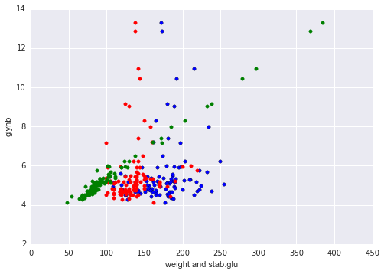
Linear Regression Model
Green – stab.glu
Blue – Weight
Red – bp.1s

Slide 43
Questions?

Slide 44
Thank You !!! Sinan
I’d like to thank Sinan, for being awesome, interested in our problems, working with us over weekends.
I’d like to thank all the TA’s Ramesh, Liam and Patrick
Also wanna thank Vanessa, for constantly checking on how were doing, the feedback forms and the Slack and just being really collaborative.

Slide 45
References
Department of Biostatistics at the Vanderbilt University
http://cs-people.bu.edu/dgs/courses/cs105/hall_of_fame/awm.html
http://www.cdc.gov/diabetes/pubs/pdf/diabetesreportcard.pdf
http://www4.stat.ncsu.edu/~boos/var.select/diabetes.html
http://cs-people.bu.edu/dgs/courses/cs105/hall_of_fame/awm.html
http://www.cdc.gov/diabetes/pubs/pdf/diabetesreportcard.pdf

Slide 46
GitHub – Karun Siddana
https://github.com/ksiddana/SF_DAT_15_WORK

